Slide 1
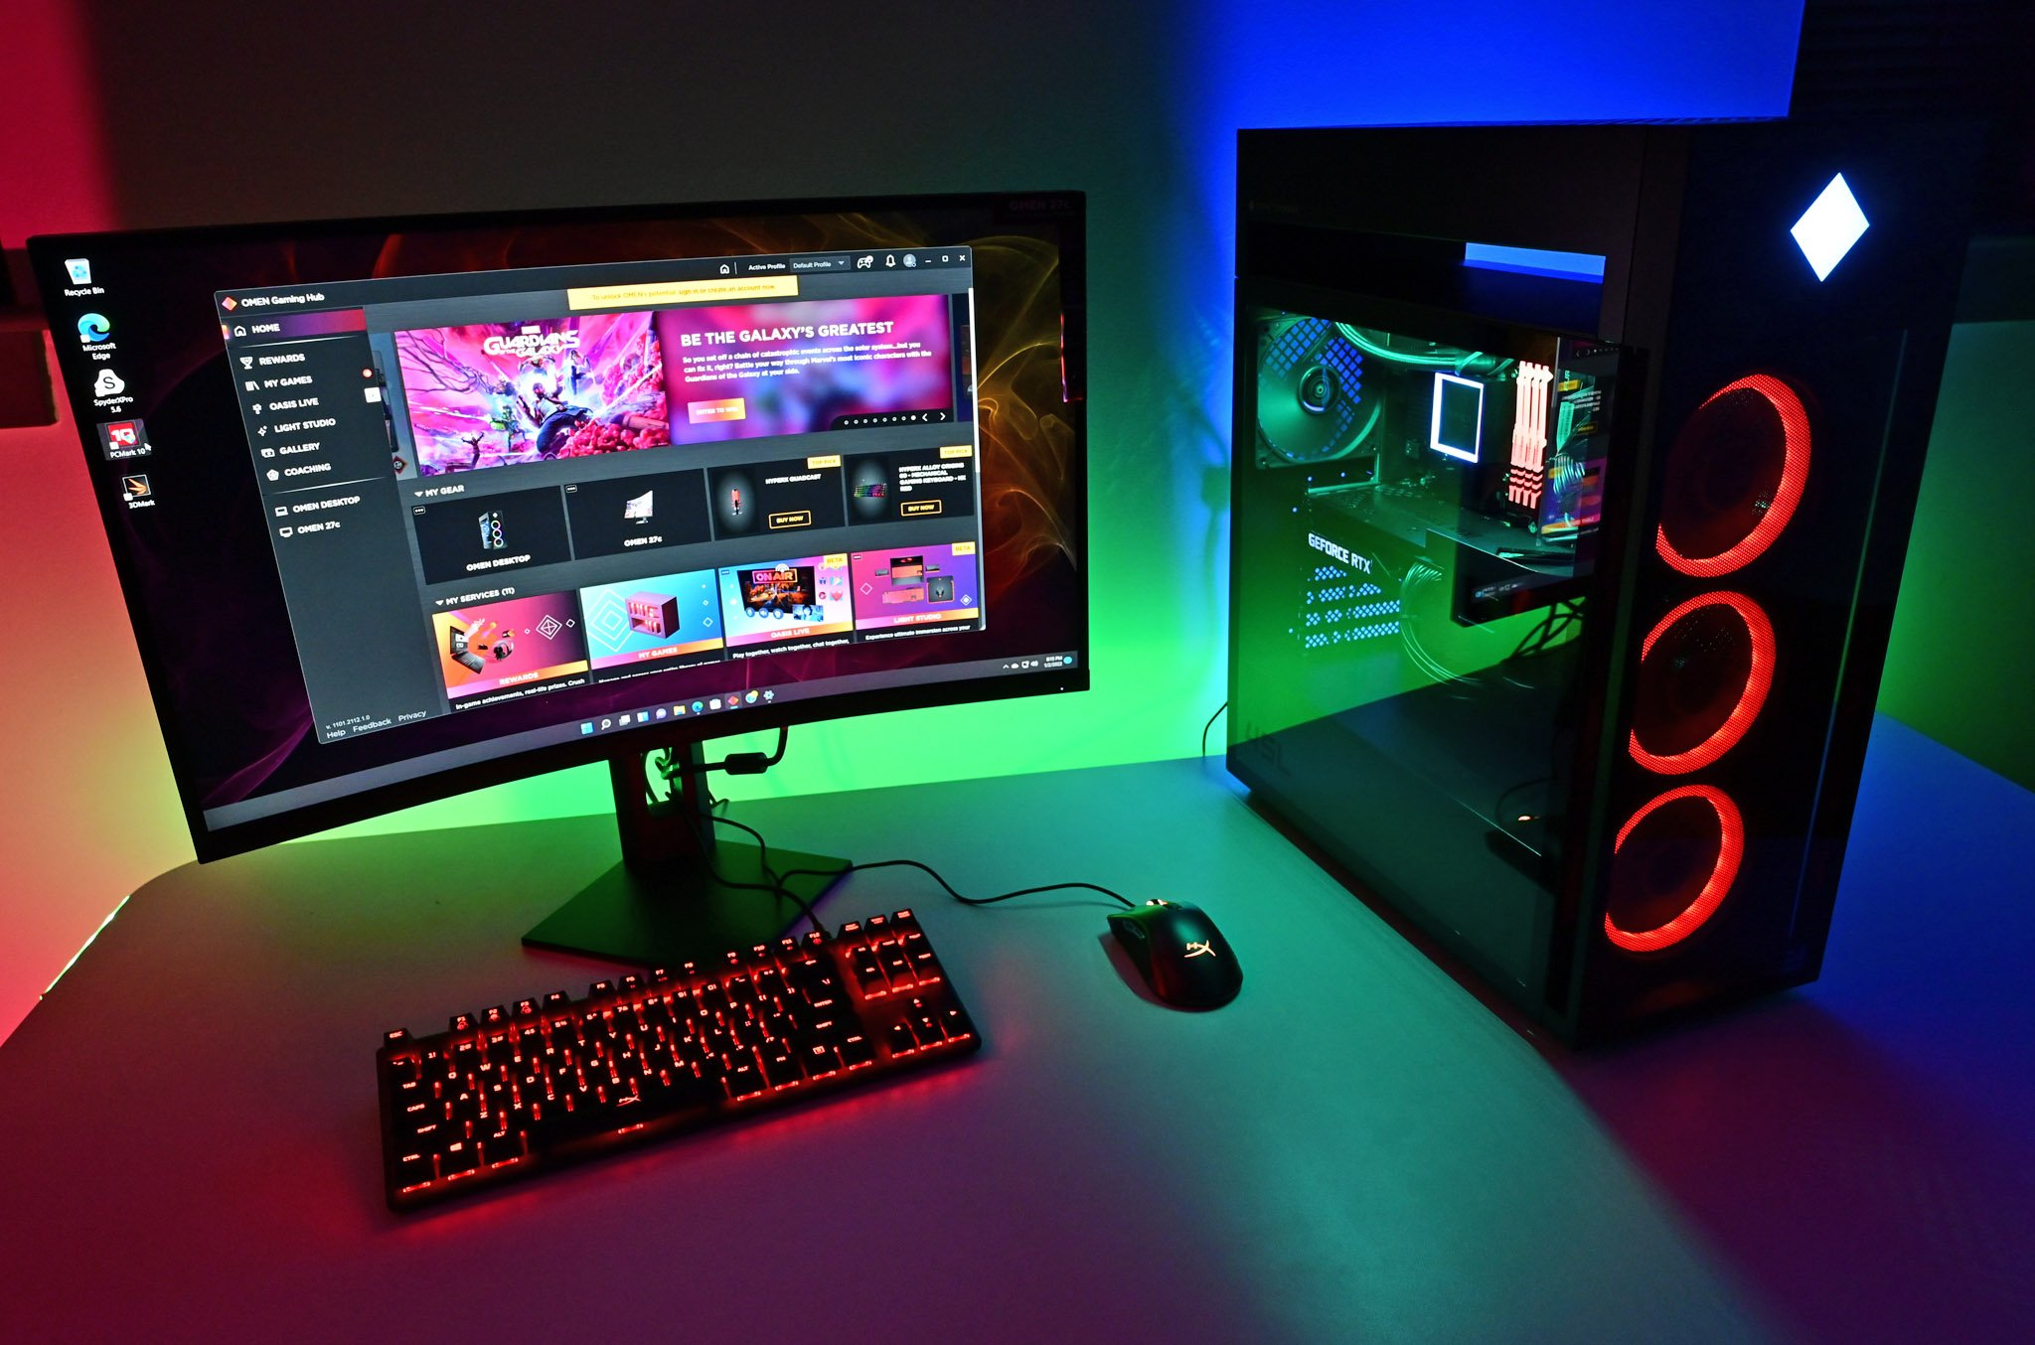
Компьютерийн техник хангамж
Хадгалах байгууламж
6
1
Оролтын төхөөрөмж /Удирдлагын хэсэг/
Эх хавтан нэмэлт карт /бусад оролт гаралт/
5
2
Санах ой /дамжуулах хэсэг/
Гаралтын төхөөрөмж /Мэдээлэх хэсэг/
4
3
Төв процессор /боловсруулах хэсэг/

Slide 2



•Daily active user 1090 Million Monthly active user 1650 Million
•Daily active user 316 million Monthly active user 400 million
•Monthly active users 1000 Million •Video watched Monthly 1 Billion Hours
Facebook
Twitter
Youtube

Slide 3
Internet user in the World by regions –June 30, 2018
Source: Internet world stats

Slide 4
Internet use by gender
Source: Surveys conducted 2000-2018. Data for each year based on a pooled analysis of all surveys conducted during that year.
89% Male
87% female
Source: Surveys conducted 2000-2018. Data for each year based on a pooled analysis of all surveys conducted during that year.
Source: Surveys conducted 2000-2018. Data for each year based on a pooled analysis of all surveys conducted during that year.

Slide 5
